Slide 1
eeFEX Manual Feature Detection using Multispectral Satellite Images
Josh Friedman

Slide 2

Motivation
To use free worldwide databases of multi-spectral satellite imagery for manual feature identification and extraction with a single convenient tool

Slide 3



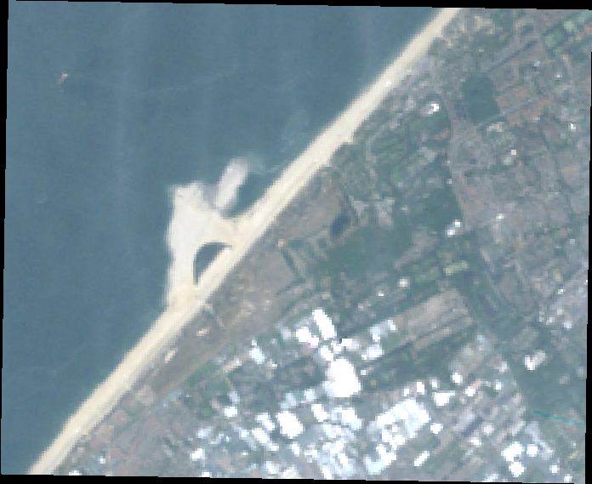
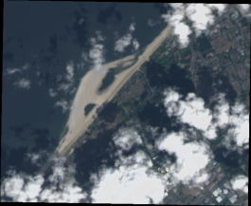
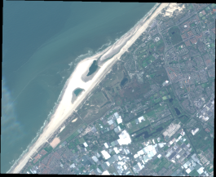
Conceptual Framework
Links cloud computing platform with local analysis tools
Written in python (intended as a single *.exe for later use)
Requires a developer Google Earth Engine account

Slide 4
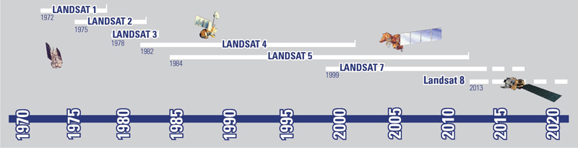
Google Earth Engine
Cloud computing platform for analyzing multi-spectral satellite imagery
Allows calculations and analysis on Google servers
No strain on the local hardware/services
Its servers contain over 900 TB of satellite imagery (and growing!)
Landsat missions (4/5/7/8)
Sentinel missions (S1, S2)
Digital Elevation Models
…
Released custom built API (Javascript + Python)

Slide 5
Capabilities
Inputs
Project Name
Satellites
Spatial Extents (clickable polygon)
Temporal Extents
Minimum Cloud Cover
EPSG Code
Output
Cloud cover analysis based on selected location and images
Individual satellite images saved locally (*.png, *.pgw)
Extracted feature locations in time (*.png, *.ldb, *.kml)

Slide 6
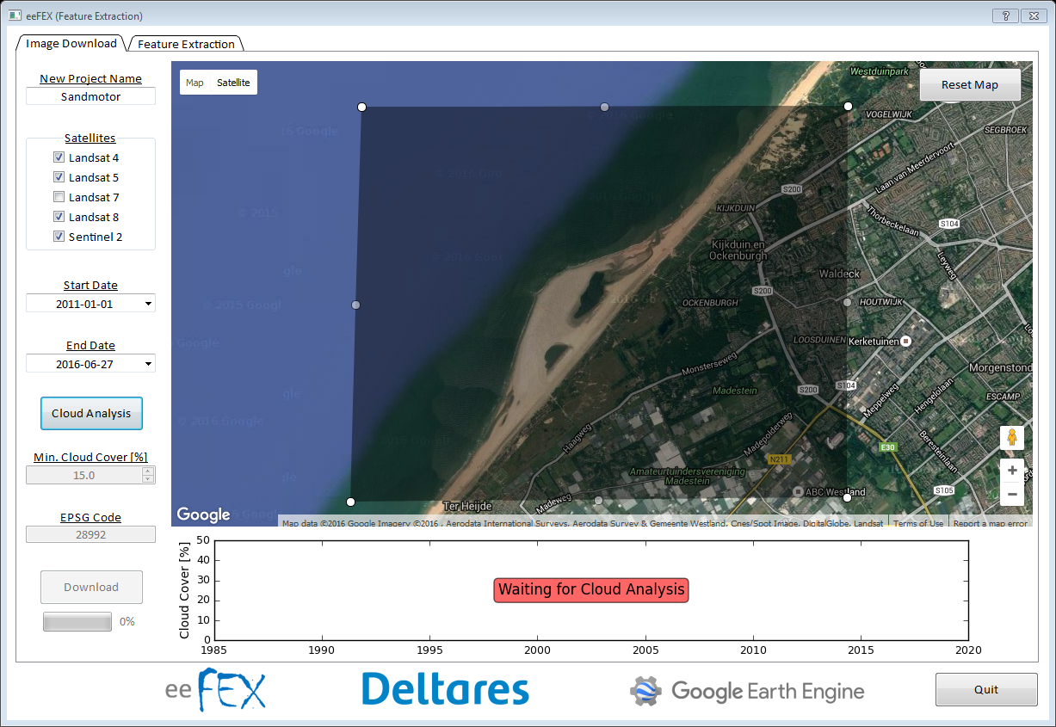
eeFEX - Typical Usage

Slide 7
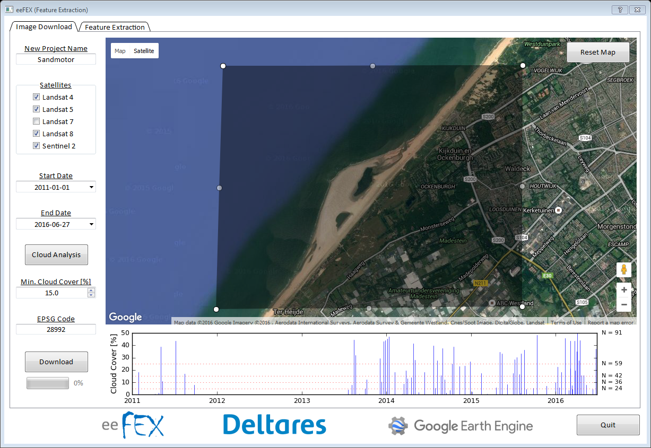
eeFEX - Typical Usage

Slide 8
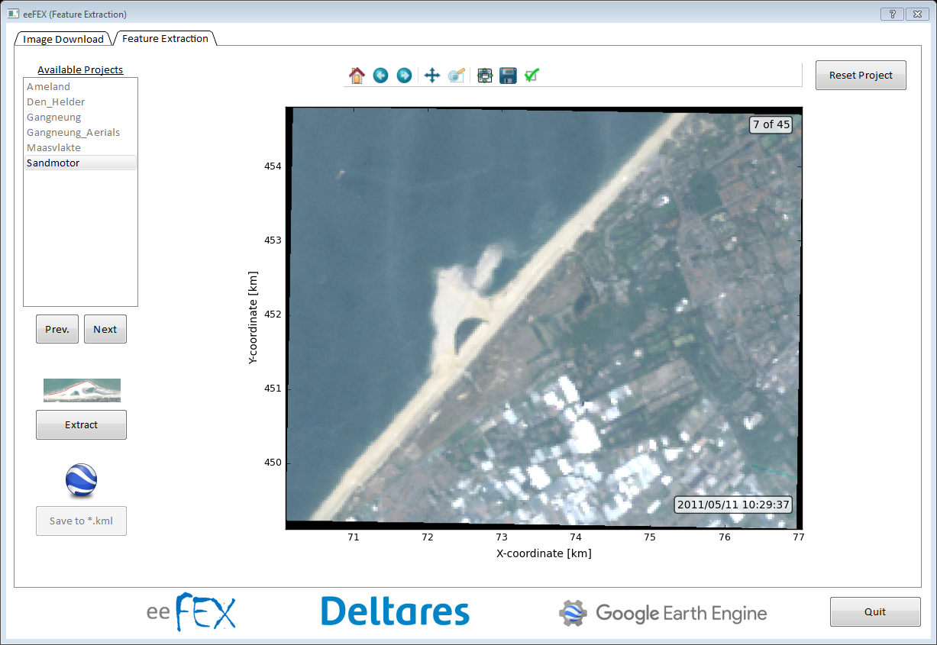
eeFEX - Typical Usage
Able to select a
different project

Slide 9
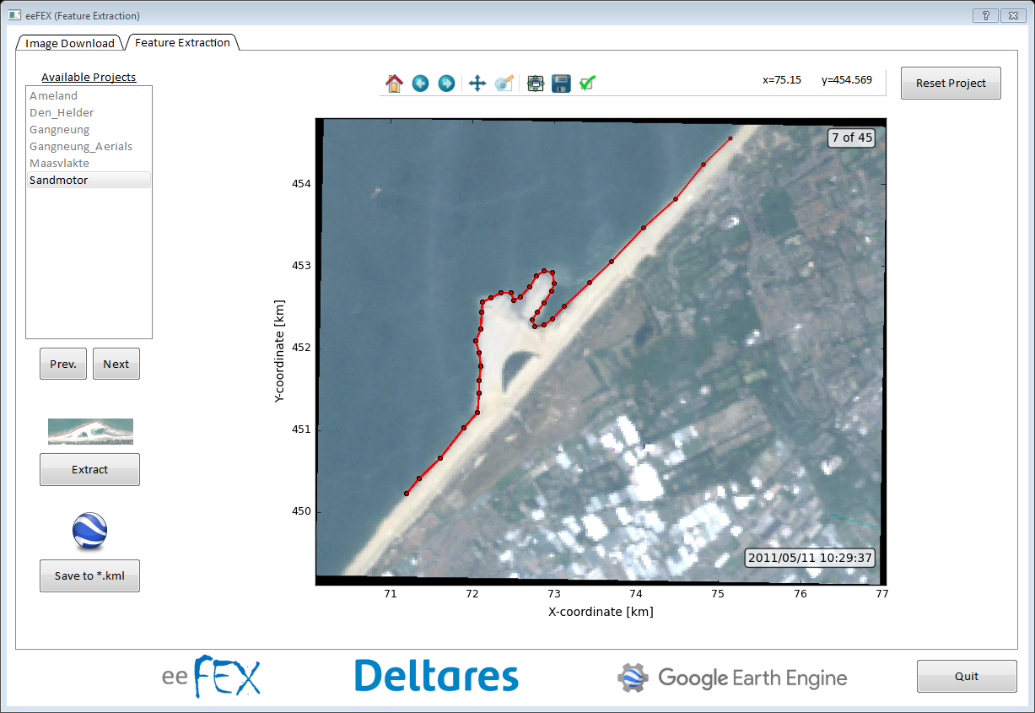
eeFEX - Typical Usage

Slide 10
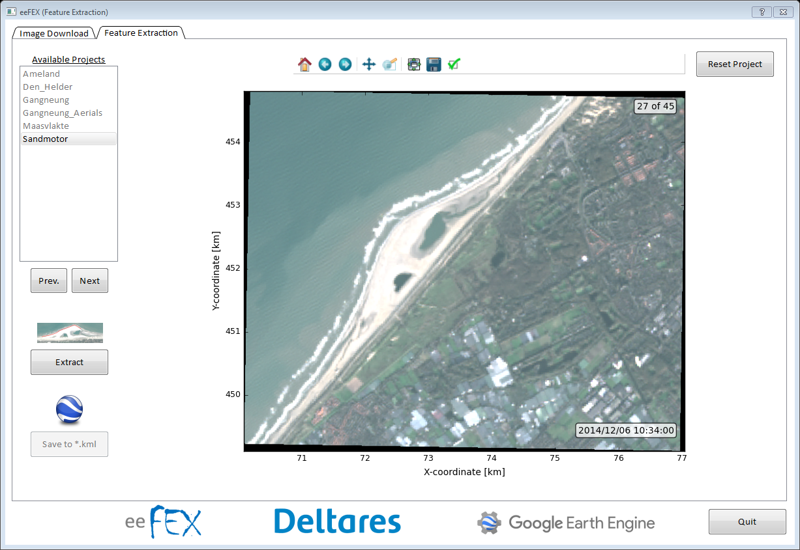
eeFEX - Typical Usage

Slide 11
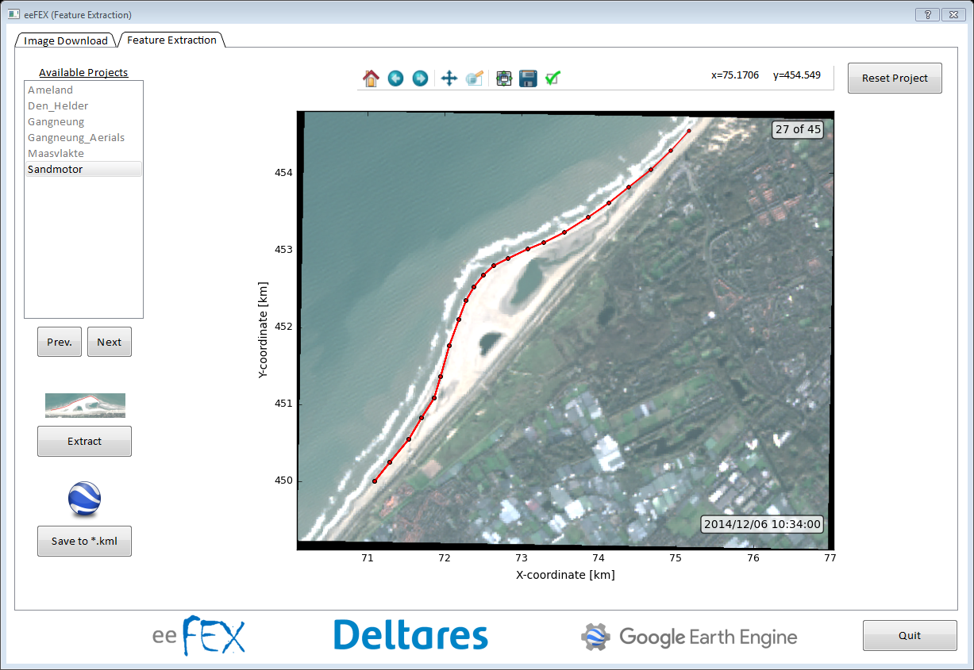
eeFEX - Typical Usage

Slide 12
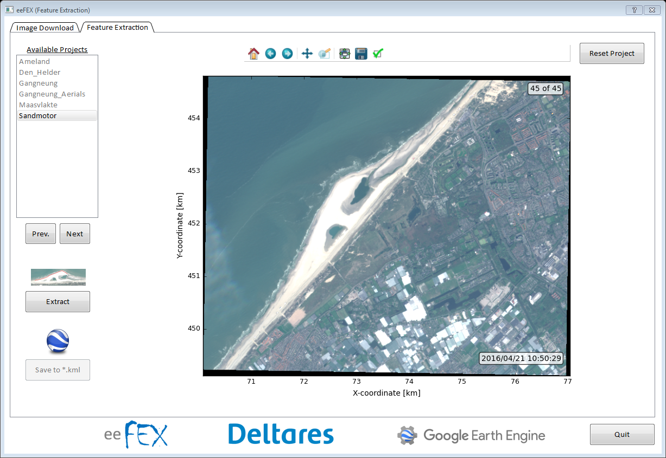
eeFEX - Typical Usage

Slide 13

eeFEX - Typical Usage

Slide 14
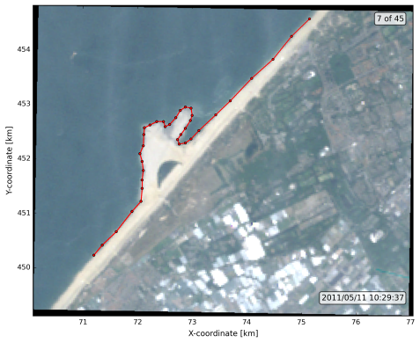
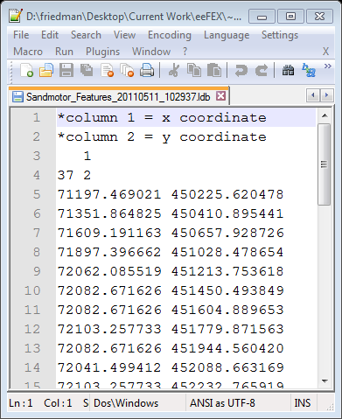
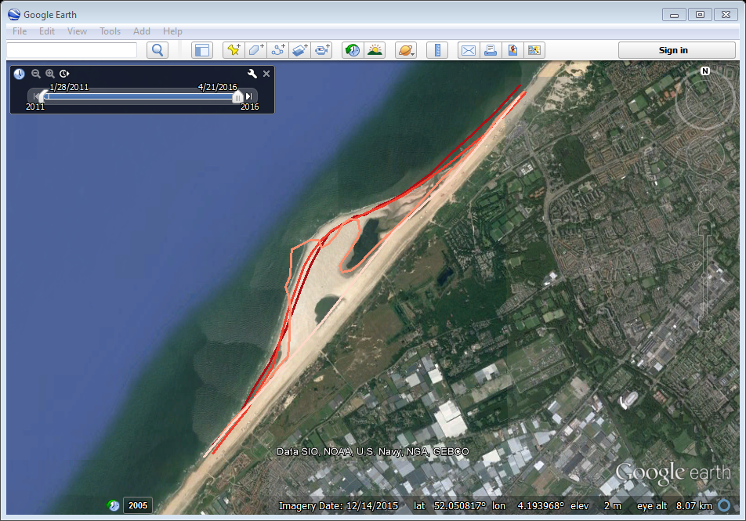
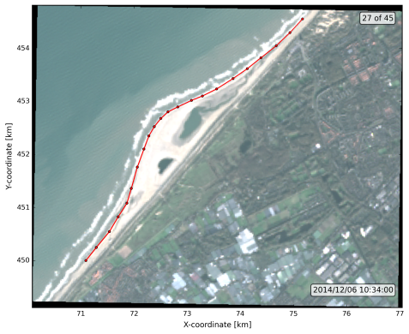
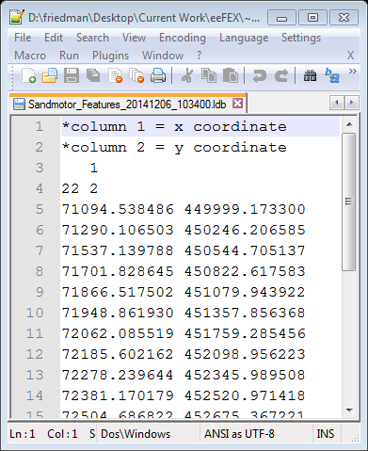

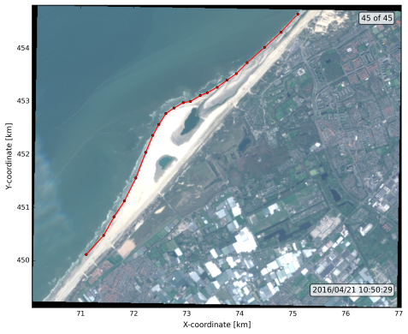
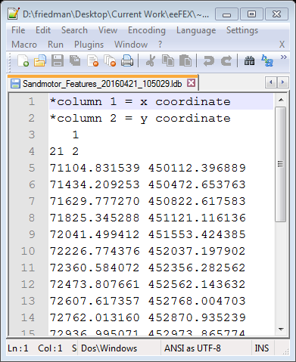
eeFEX - Typical Usage

Slide 15
Demo

